Slide 1


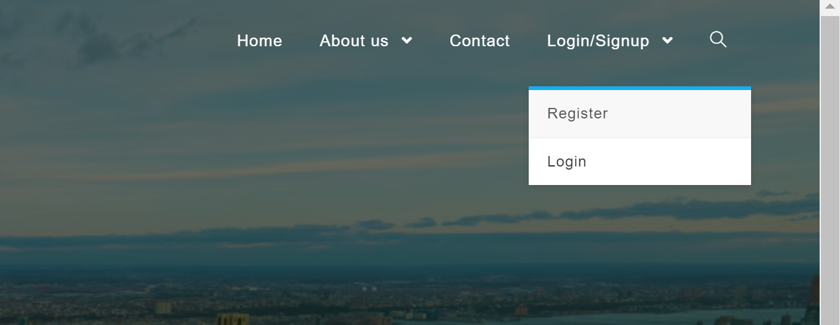
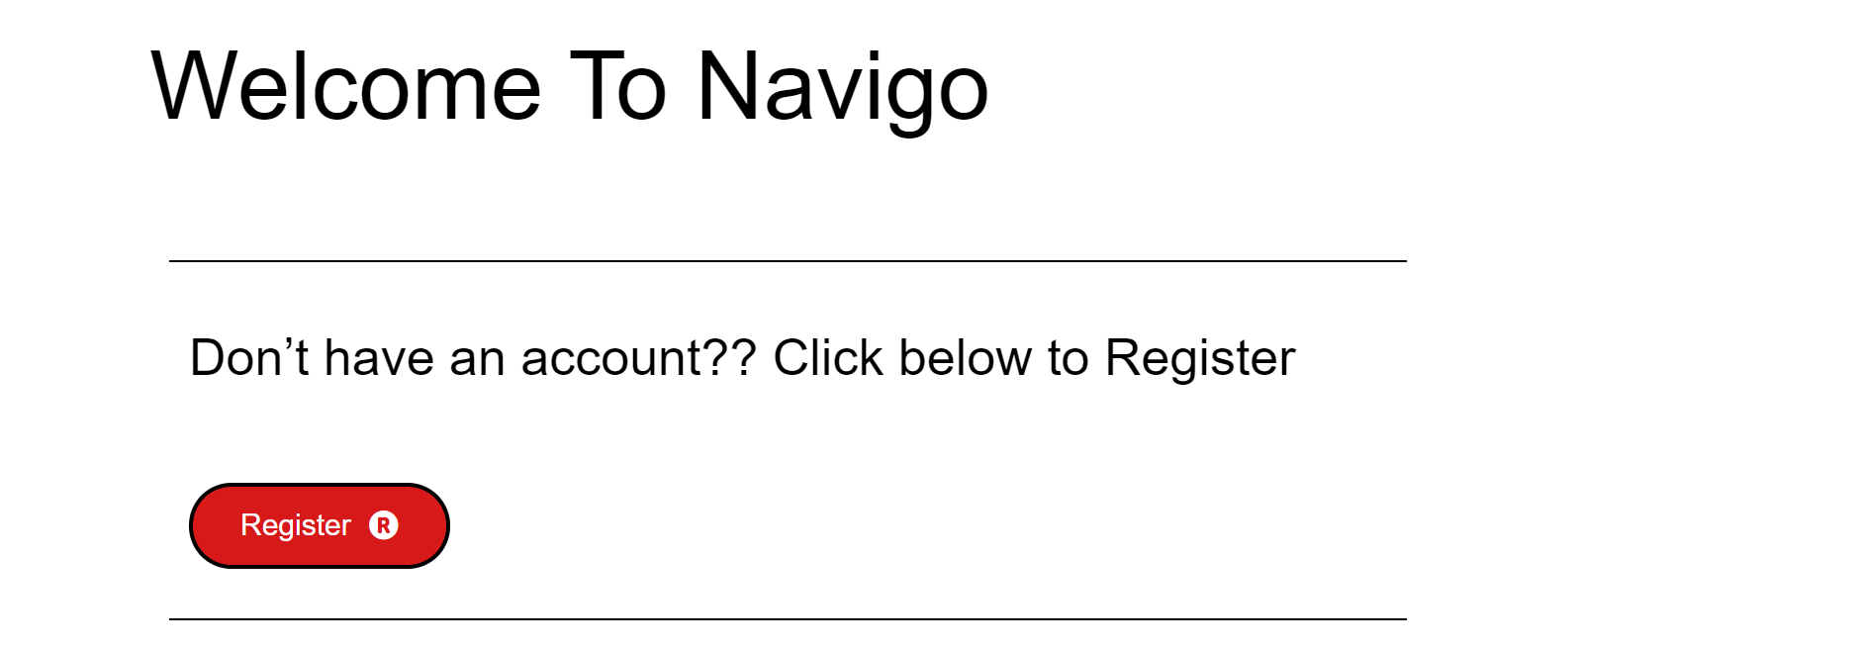
User Stories
Registration User Story (Sign up):
Scenario 1: Unregistered User should see a link to user signup:
Given an unregistered user. When the user enters our website, a link to sign up as a user should be available for the user. Using either the “Get started icon” or “Register” from Login/Sign up drop down menu, the user can access the link for sign up.
Scenario 2: Unregistered User should see a registration form:
Given an unregistered user. When the user clicks on” Don’t have an account?? Click below to Register”, then the user should see a form allowing the user to sign up for our website. By clicking the register button below the “ Don’t have an account?? Click below to Register” prompt, the user can see the registration form.

Slide 2
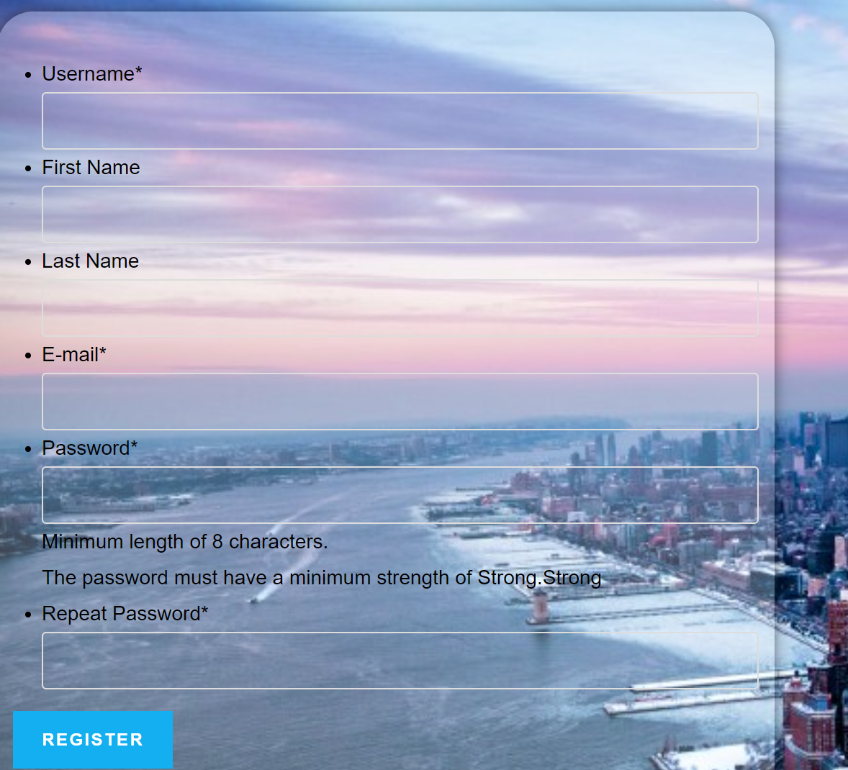
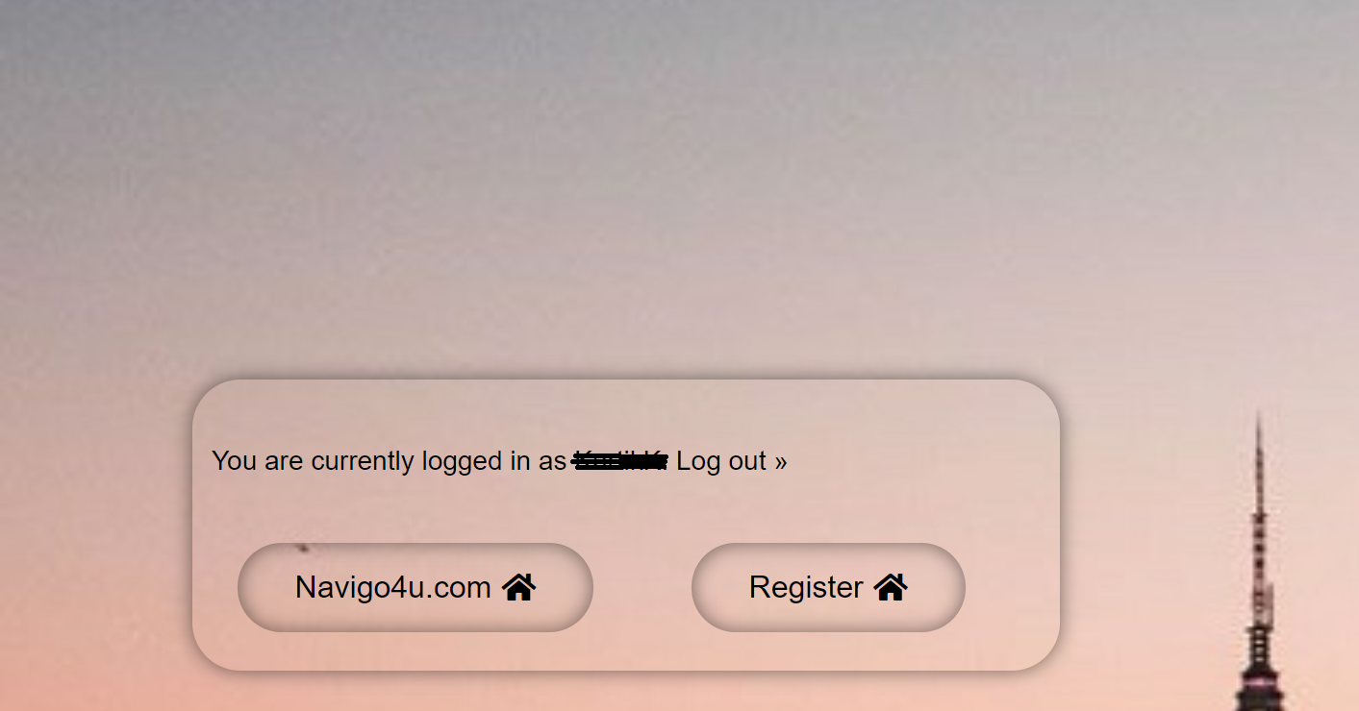
User Stories
Scenario 3: Unregistered User should receive confirmation email on signup:
Given an unregistered user. When the user fills out the sign up form and clicks submit, then the user should receive a confirmation email with a link from Navigo that activates the user’s account. The following fields are to filled up by the user, in the registration form.
Username
First Name
Last Name,
E-Mail
Password (Strong Password with a minimum of 8 characters)
Scenario 4: Unregistered User should be able to activate user account:
Given an unregistered user. When the user receives and activates the account confirmation link, the user should be able to have his account activated (registered account), through which he can use our services.

Slide 3
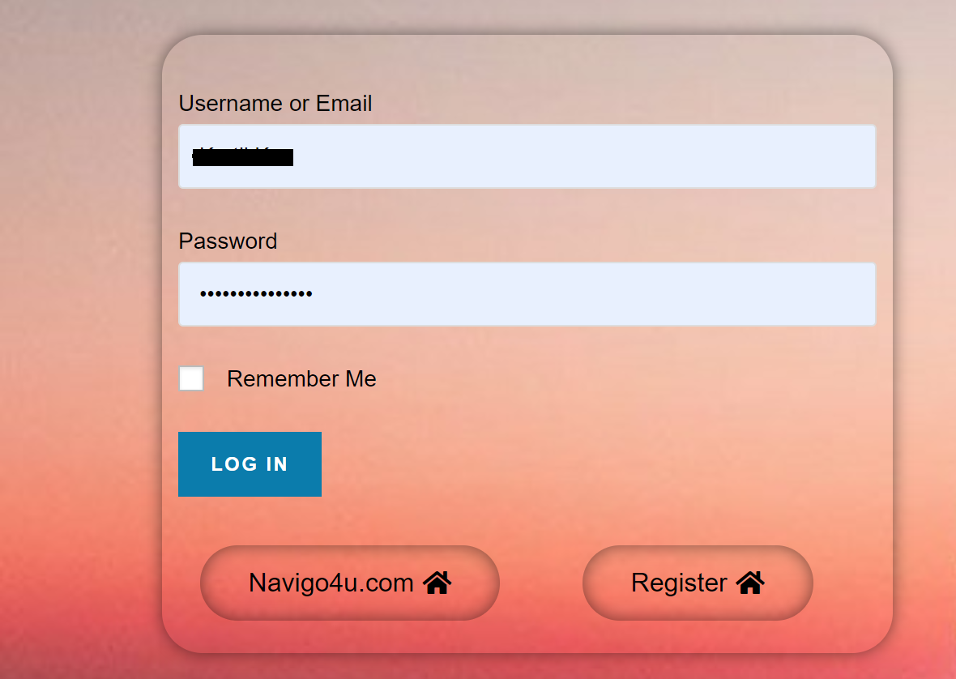
User Stories
Login Page User Story:
Scenario 1: Registered User should be able to enter the login credentials on the login form:
Given a Registered user. When the user enters our (Navigo) website, The user should see login screen with input data fields for
1) Username
2) Password
Scenario 2: Registered User should be able to successfully login with his correct credentials.
Given a Registered user. When the user, User should be able to successfully login using his correct username and password. He should also see a screen that displays “you are currently logged in as xyz”.

Slide 4
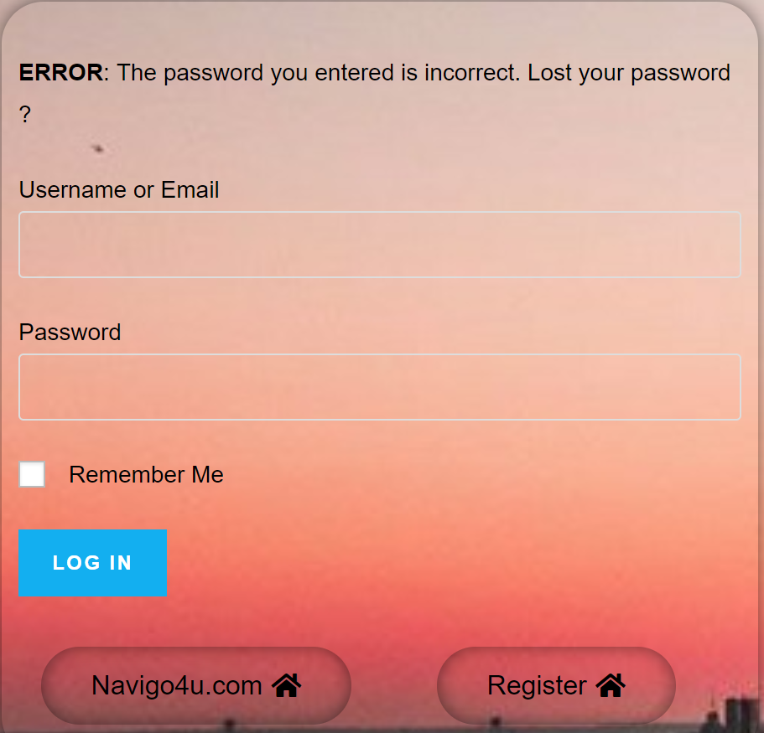
User Stories
Scenario 3: Registered User should get a prompt if the user enters incorrect credentials.
Given a Registered user: When a user enters incorrect login credentials (username, password or both), our Navigo website should display a message the following message to the user, “The password you entered is incorrect. Lost your password?”. The user is notified about an unsuccessful login with this.

